Slide 1
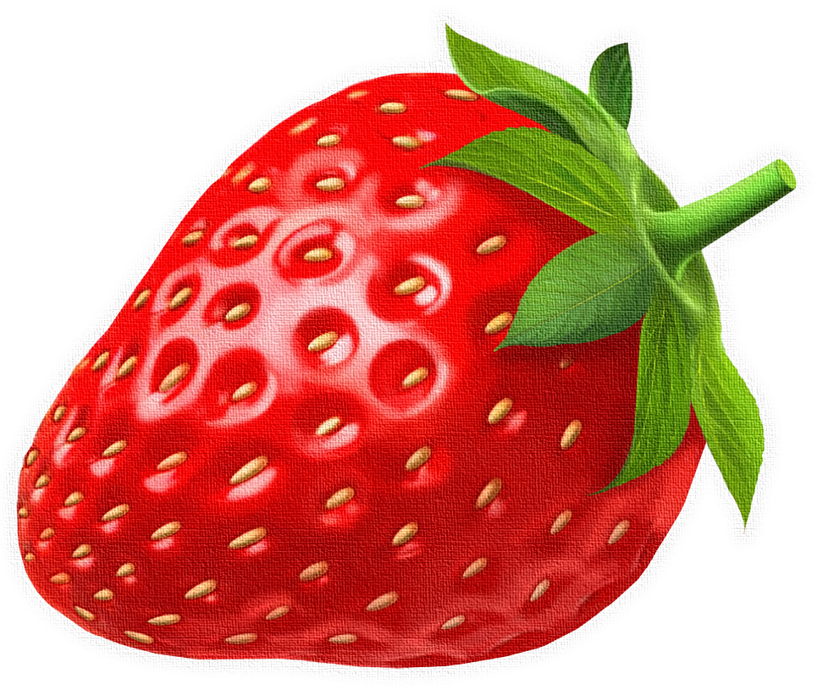
GAME –FRUIT CATCHER SSN College of Engineering, Kalavakkam Department of Computer Science and Engineering UGE3188 – Problem Solving and Programming using Python Project : Fruit Catcher Game
Presented by:
Sanjay Suresh
Shrinithi K L
Smrithi S

Slide 2
INTRODUCTION:
The "Fruit Catcher" game is a simple yet captivating project that introduces fundamental concepts of game development using Python and the Pygame library. This project combines creativity, programming logic, and problem-solving to create an interactive gaming experience. Players control a basket to catch falling fruits, earning points and avoiding penalties for missed fruits. The game’s straightforward mechanics and engaging gameplay make it an excellent project for learning and practicing game development techniques.

Slide 3
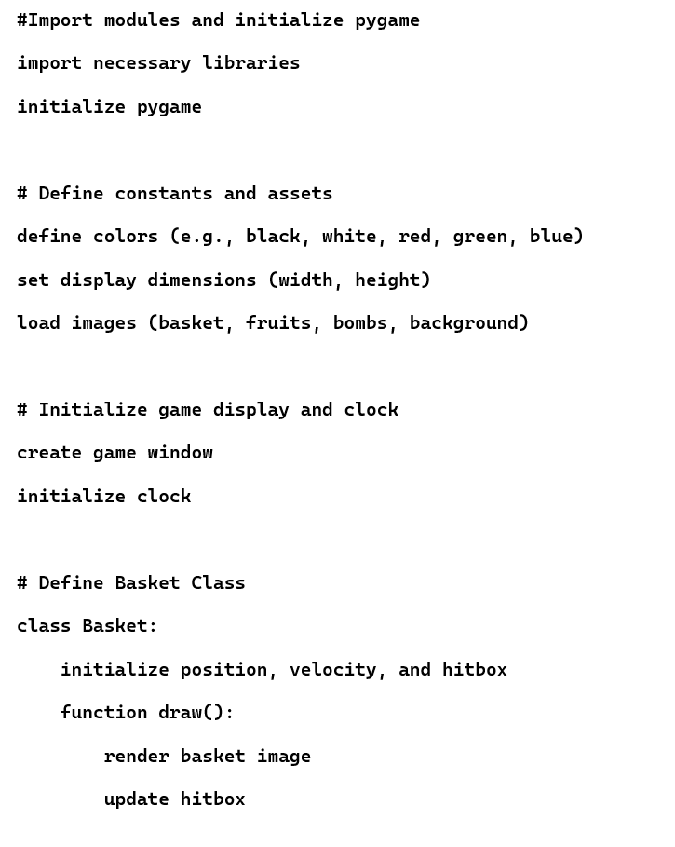
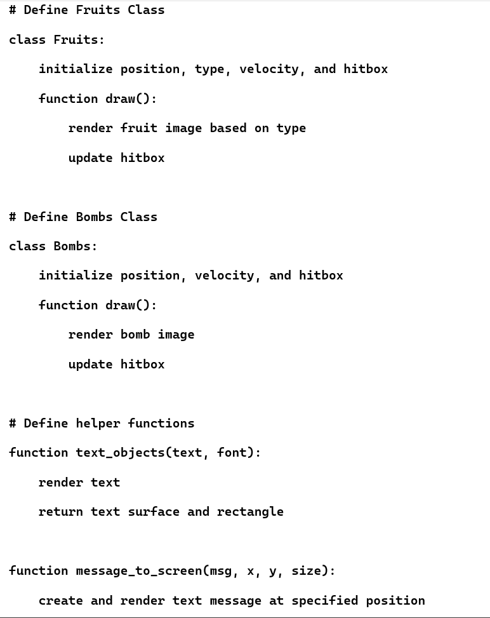
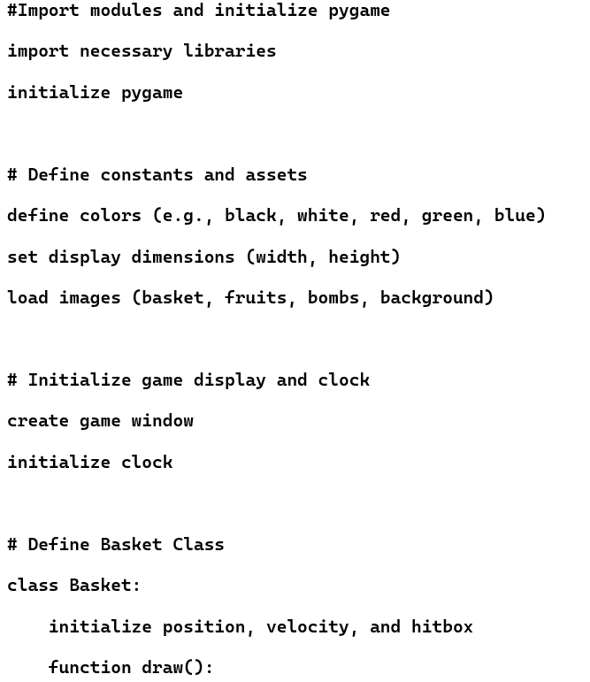
PSEUDOCODE:

Slide 4
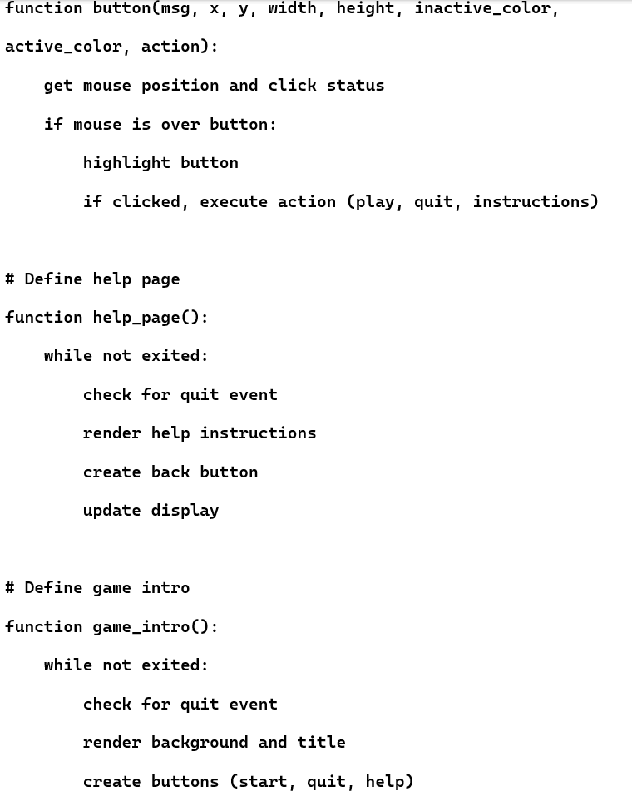
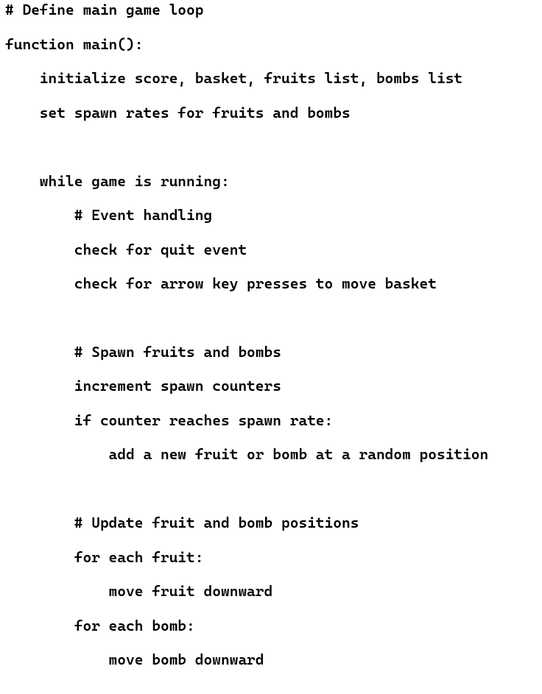

Slide 5
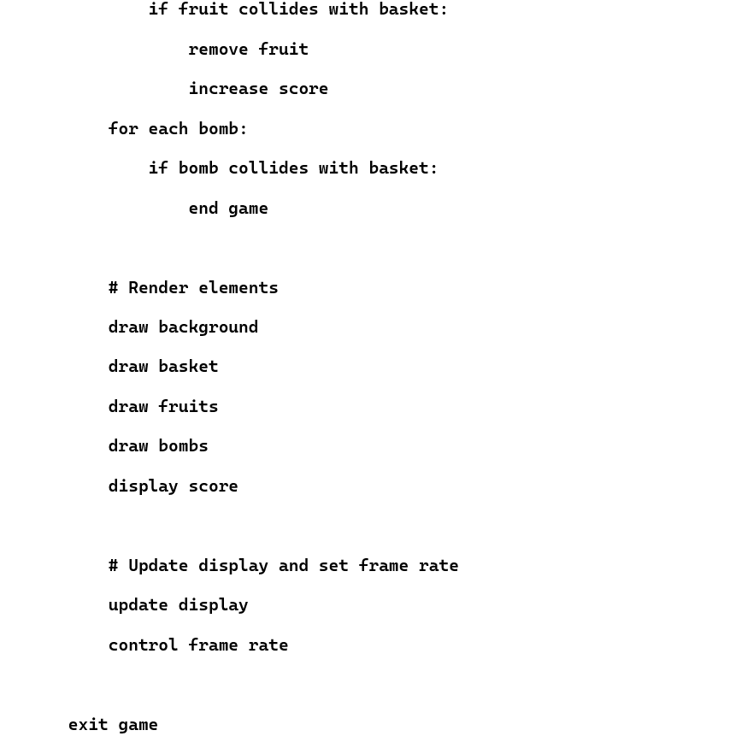
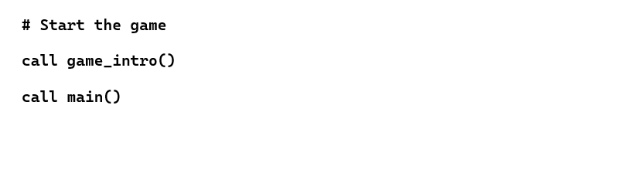

Slide 6
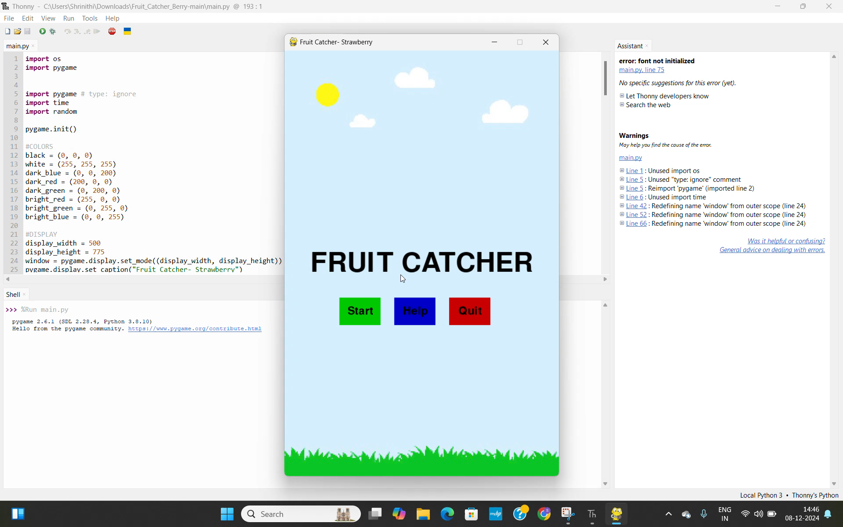
DEMO VIDEO:

Slide 7
LEARNING OUTCOMES:
Through this project, the following skills and knowledge can be acquired:
Game Development Skills:
Understanding of game loops, event handling, and sprite management.
Knowledge of collision detection and object interaction.
Programming Concepts:
Application of OOP principles.
Effective use of Python libraries for real-world projects.
Problem-Solving Skills:
Tackling challenges related to game logic and mechanics.
Debugging and optimizing code for better performance.
Creativity and Design:
Designing engaging and user-friendly game interfaces.

Slide 8
---------------------------THE END----------------------------

